Slide 1
RAYALASEEMA UNIVERSITY KURNOOL
B. ANITHA
b.sc(mpcs)
21360008002

Slide 2
PROJECT NAME
UNVEILING INSIGHTS: EFFECTIVE THREAT MITIGATION WITH QRADAR

Slide 3
UNVEILING INSIGHTS: EFFECTIVE THREAT MITIGATION WITH QRADAR
TEAM ID : LTIP2024TMID14085
TEAM SIZE : 5
TEAM LEADER : BOYA ANITHA
TEAM MEMBER : SHAIK REENA TASLEEM
TEAM MEMBER : YERRALA ASHOK
TEAM MEMBER : YERRAVATI RAMUDU
TEAM MEMBER : YERRAMU PRATHIBHA

Slide 4
ConTENTS
ABSTRACT
INTRODUCTION
IBM
IBM QRADAR
SIGNIFICANCE OF IBM QRADAR
QRADAR SIEM MEANING
QRADAR PRODUCTS
FEATURES
CYBER SECURITY
CONCLUSION

Slide 5
ABSTRACT
The modern era of IBM arguably began in 1981 with the Personal Computer 5150, or the “PC.” This was one of the first computers intended for consumer use rather than dedicated to business or the government. IBM partnered with Microsoft (MSFT) , a relatively new company, to run MS-DOS as the operating system on these machines.
In that same era, IBM invented the architecture for “local area networks.” This would become first the office networks that users came to rely on, then the basis for the global networks that connect users on the internet, and finally the home networks that most households use today. It also created one of the modern benchmarks for artificial intelligence with its Deep Blue thinking system. This AI became most famous for its series of chess games against world champion Garry Kasparov in the 1990s, culminating with Kasparov’s defeat in 1997.
Yet at the same time, as the 1980s and 1990s saw IBM pioneer desktop computing, the company also lost its status as the market leader. Clones of the IBM machine and business model quickly sprang up throughout the consumer market, with numerous other companies selling PC machines running Microsoft’s operating system. Although for several years IBM’s cultural presence was strong enough that these machines were known as “IBM clones,” eventually the company became just another competitor in a crowded market.
At the same time, its historic dominance in market for large, installed mainframes began to hurt IBM as computing got smaller and faster. The company was ill-equipped to respond to an era in which mainframes were replaced by small servers. Over the course of the 1990s, IBM’s core business model and profit centers moved away from technology. By the end of the decade the firm saw much, if not most, of its growth in business services, such as helping clients build networks and install servers.

Slide 6
INTRODUCTION ;
Unveiling insights : Effective Threat mitigation with QRADAR ,likely refers to a process or presentation focused on demonstrating how to use IBM QRadar, a Security Information and Event Management (SIEM) system, to identify and mitigate security threats. Here's a breakdown of what it might involve:-
Understanding Threats:
An overview of common cybersecurity threats, such as malware, ransomware, insider threats, phishing, and others.
Introduction to QRadar:
A brief explanation of what QRadar is and its role in security monitoring, incident response, and threat detection.- **Threat Detection with QRadar**: How QRadar collects and analyzes security logs, network traffic, and other data sources to identify potential security threats.
Using QRadar for Threat Mitigation:
This could include discussing specific QRadar features and tools for responding to threats, such as creating alerts, automating responses, and conducting forensic analysis.
Continuous Improvement:
Discussing the importance of constantly updating threat intelligence and adapting QRadar to address evolving threats.In essence, this topic focuses on exploring how QRadar helps organizations maintain a robust security posture by effectively detecting and responding to threats, along with sharing tips and best practices for maximizing its utility.

Slide 7
INTERNATIONAL BUSINESS MACHINES
IBM is known for its wide range of products and services, including its mainframe computers, which are used by many large corporations and government agencies around the world. IBM is also known for its AI-powered Watson platform, which is used in a variety of applications such as healthcare, finance, and customer service. Additionally, IBM is a well-known provider of IT services and consulting, helping businesses to optimise their operations and implement new technologies. In recent years, the company has also built up its efforts in Cloud computing and quantum computing, and has made several failed ventures into blockchain platforms.
IBM is known for its hardware and software products, including computers, servers, storage systems and networking equipment. It also provides consulting, technology and business services, such as cloud computing, data analytics and artificial intelligence (AI). IBM's research and development efforts have contributed to numerous technological innovations, including the development of the first programmable computer, the first hard drive and the first computer virus.

Slide 8
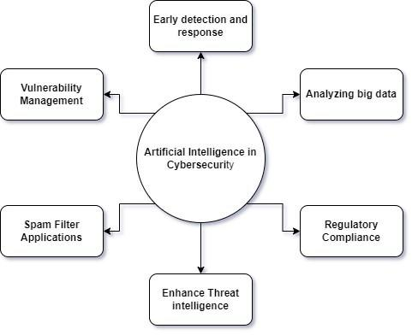

Slide 9
IBM QRADAR
The IBM Qradar is a security information and event management or SIEM product that is designed for enterprises. The tool collects data from the organization and the network devices. It also connects to the operating systems, host assets, applications, vulnerabilities, user activities, and behaviors. IBM Qradar is used to perform analysis of the log data and the network flows in real-time so that malicious activities can be identified and stopped as soon as possible. Thus, the main aim of the IBM Qradar is to prevent or minimize the damage to its host organization.
The IBM Qradar SIEM uses a real-time integrated Cybersecurity AI, machine learning, and behavior analytics to prevent the attacks in the blink of an eye and with a very less cost compared to what human supervision can ensure. Qradar can address the bulk security issues that the companies face and save a lot of money. The security teams that struggle with patching endpoints properly and updating them can get their problems solved with IBM BigFix that has Qradar SIEM integrated into it. Most of the common issues are solved with this.
The Qradar Security Information and Event Management is an essential tool that would aid the security teams in prioritizing the threats across the enterprise and detecting them accurately. The tool offers the necessary intelligent insights that would help the teams to respond as quickly as possible and reduce the impact of the incidents. Network flow data and log events from thousands of endpoints, devices, and applications over the network

Slide 10
Significance of IBM Qradar;
IBM QRadar is revolutionizing security integration and is helping organizations all around the world to protect their data. Today product deployments can take place in lots of different scenarios and it is hard for companies to track every pathway. This is where IBM QRadar comes in to help the organizations stabilize their security and protect themselves against potential threats.
The following is the significance of IBM QRadar :
Comprehensive visibility - The product helps to gain a centralized insight into the data flows, events, and logs on the SaaS (software-as-a-service) and IaaS (infrastructure-as-a-service) environments and on-premises.
Elimination of manual tasks - All the events in a certain threat can be centrally seen in one place and the expensive manual tracking can be eliminated. Analysts can focus on investigating the matter (security threat), followed by a proper response.
Easily cater to the compliance protocols - It becomes easier to comply with the international policies and the external regulations that are achieved by leveraging the pre-built reports and templates.
Real-time threat detection - Out-of-the-box analysis is leveraged that analyzes the network flows and logs automatically and generates proper alerts and the attacks are then directed via the proper kill chain.

Slide 11
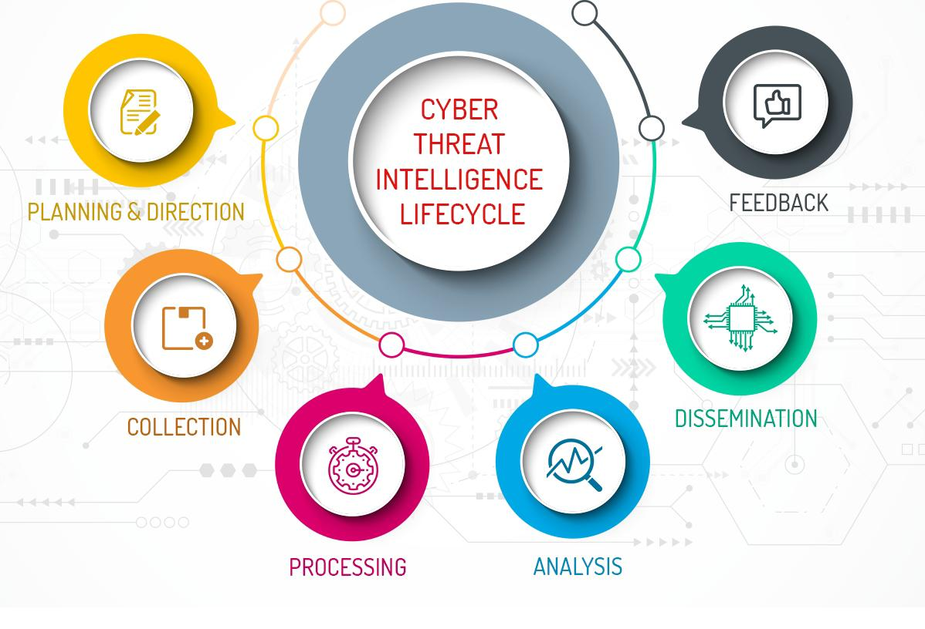

Slide 12
QRadar SIEM Mean;
IBM Security Operations QRadar is an enterprise security information and event management (SIEM) product that can be integrated easily for supervising security workflows. The two workflows that are included in the base system include - Run Enrichment for IP and Security Incident Enrichment.
If the Source IP, Configuration Item or Destination IP are modified in a security incident, The REST calls to the second workflow are caused by a business rule. A call would be made for each of the modified fields. Following this, the Security Incident Enrichment workflow would make calls to QRadar depending on the modified fields. QRadar then sends the enriched data to the security incident and populate the work notes with a summary of the event flows and offenses related to the IP addresses.
QRadar demonstrates a modular architecture where deployments of various sizes and topologies are supported. All the software components run on a single appliance in a single-host deployment. The QRadar console provides the user interface and real-time events, reports, asset information, offenses, and administrative functions. Event management requires the supervision of several things like data nodes, the QRadar components, system health, network interface, network, and off-site hosts.

Slide 13
QRadar products
Qradar SIEM;
The market-leading QRadar SIEM uses AI, network and user behavior analytics, along with real-world threat intelligence to provide security analysts with more accurate, contextualized and prioritized alerts.
QRadar SOAR ;
Recent winner of a Red Dot Design Award for interface and user experience, QRadar SOAR helps organizations automate and orchestrate incident response workflows and ensure their specific processes are followed in a consistent, optimized and measurable way.
QRadar EDR ;
Protect your endpoints against previously unknown zero-day threats using automation and hundreds of machine learning and behavioral models to detect anomalies and respond to attacks in near real time. By using a unique approach that monitors operating systems from the outside, organizations can now avoid manipulation or interference by adversaries.
QRadar Log Insights ;
QRadar Log Insights is a cloud-native log management and security observability product that provides simplified data ingestion and rapid search, investigations and visualizations. By using an elastic security data lake, analysts can now perform analytics on terabytes of data with greater speed and efficiency.

Slide 14
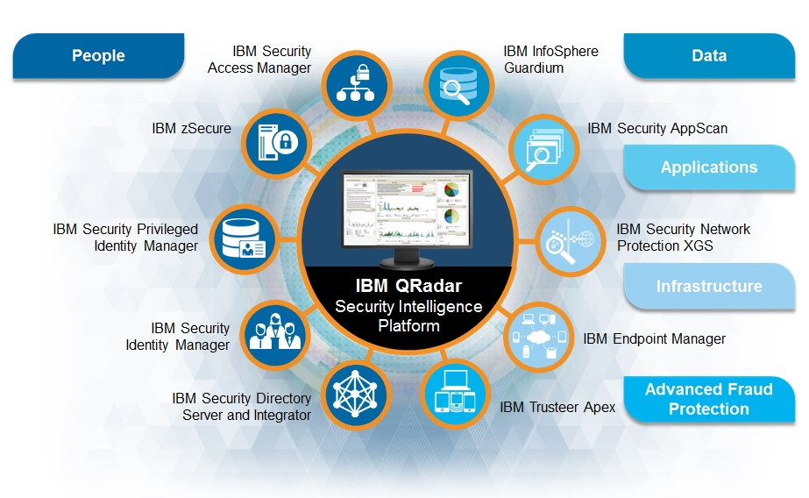

Slide 15
FEATURES
Threat investigation ;
Threat Investigator works with Case Management to find cases that warrant an investigation and automatically starts investigating. The investigation fetches artifacts attached to the case and starts data mining. After Threat Investigator completes several rounds of data mining, it generates a timeline of the incident that consists of MITRE ATT&CK tactics and techniques plus a chain graph of the incident.
Data collection ;
Data collector makes it possible to get telemetry data set up and ingest with just a few clicks. It supports many protocols, including passive and active. Passive protocols listen for events on specific ports while active protocols use APIs or other communication methods to connect to external telemetry that poll for events.
Detection and response center ; The center streamlines the adoption of new use cases by centralizing management of detection and response use cases, reducing complexity and improving efficiency. You can use rules management across cloud or on premises to view, create and adjust with the easy-to-use rule editor.

Slide 16
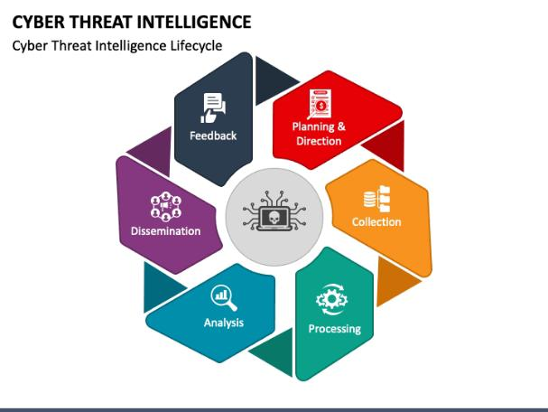

Slide 17
CYBER SECURITY
The technique of protecting internet-connected systems such as computers, servers, mobile devices, electronic systems, networks, and data from malicious attacks is known as cybersecurity. We can divide cybersecurity into two parts one is cyber, and the other is security. Cyber refers to the technology that includes systems, networks, programs, and data. And security is concerned with the protection of systems, networks, applications, and information. In some cases, it is also called electronic information security or information technology security.
Today we live in a digital era where all aspects of our lives depend on the network, computer and other electronic devices, and software applications. All critical infrastructure such as the banking system, healthcare, financial institutions, governments, and manufacturing industries use devices connected to the Internet as a core part of their operations. Some of their information, such as intellectual property, financial data, and personal data, can be sensitive for unauthorized access or exposure that could have negative consequences.
Cyber-attack is now an international concern that hacks the system, and other security attacks could endanger the global economy. Therefore, it is essential to have an excellent cybersecurity strategy to protect sensitive information from high-profile security breaches. Furthermore, as the volume of cyber-attacks grows, companies and organizations, especially those that deal with information related to national security, health, or financial records, need to use strong cybersecurity measures and processes to protect their sensitive business and personal information.

Slide 18
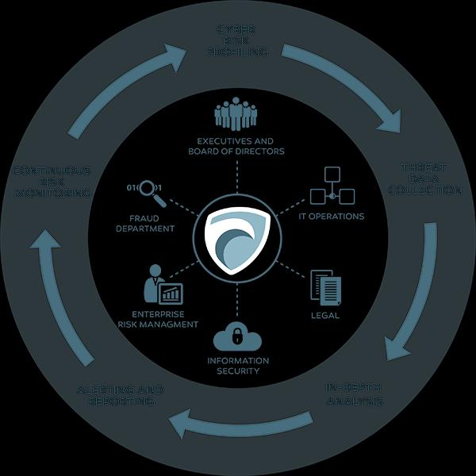

Slide 19
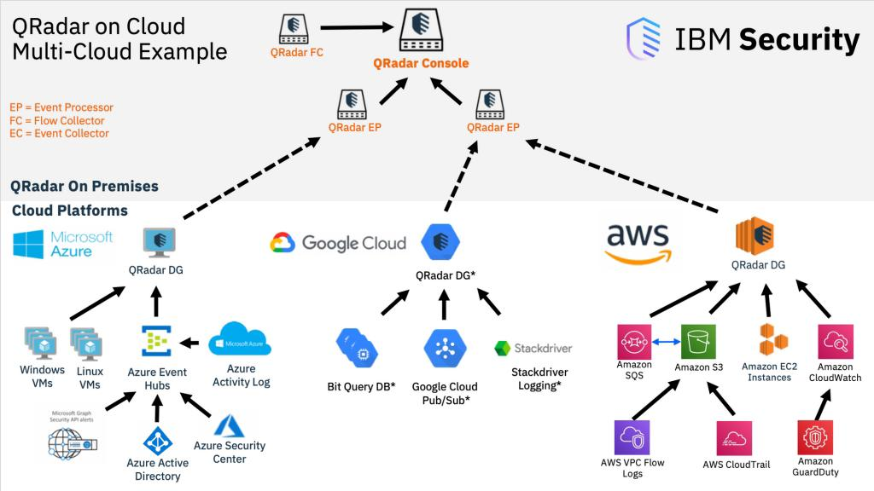

Slide 20
CONCLUSION
Whereas cybersecurity primarily focuses on data transfer and storage, network security is a bit broader. As per its name, network security involves the defense, maintenance, and recovery of networks in general. It encompasses cybersecurity as a defensive umbrella of sorts, protecting all network users from all digital threats—even if a given cyber attacker has intentions other than data exploitation.
To protect the integrity, safety, and sustainability of a network’s users, network security professionals tend to focus on connection privacy. This preference is synonymous with the practice of cybersecurity, resulting in the two terms often used interchangeably. This said, the vehicles of network security services also encompass anti-virus software, malware detection tools, firewall upgrades, virtual private networks (VPNs), and other security programs. So, even though network security and cybersecurity pros often cover similar bases, they deviate at intersections wherein things like data storage and data tracking need overlap. Of course, these intersections also tend to be serviced by additional security providers—each arriving from their own, specialized avenues of digital risk management. While these additional cyber crime defenders conduct vital services, however, they’re not as far-reaching as network security is—or even cybersecurity, for that matter.

